Slide 1
Market Research (MR):
Research Request Pipeline & Process
August 2018

Slide 2
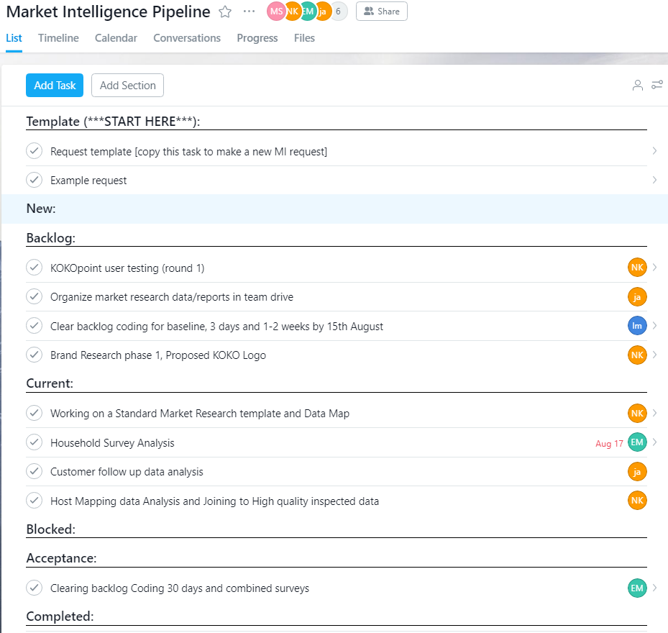
Summary of MR request process
All requests can be placed and tracked on Asana in the “Market Research Pipeline” project in Asana by making a copy of the template and filling out the details.
Requests will pass through the following stages:
New: requirements draft & ready for review by MI team
Backlog: requirements finalized by MI team and ready for work
Current: request scheduled for work during current sprint - work may include research design, research planning, data collection, data analysis, and report development
Blocked: help / clarification required before work can continue
Acceptance: request completed and ready for requester review
Completed: requester confirmed task meets requirements
When the request is accepted by the requester, the MI team will mark the task complete in Asana, and it will disappear from the task list.
MI team will track progress based on the following metrics:
Number of tasks completed each month
Percent of tasks scheduled that were completed each month

Slide 3
Detailed stages of MR requests
New
Requests can be placed on our Asana “Market Research Pipeline” project by copying “request template” into a new task
Fill in template with details of your request (see “example request” for information a request should include)
Drag new request into “New”
Backlog
MI team will review each request and ask for any clarifications needed
Once request is well defined, MI team will add to “Backlog” and indicate how many hours will be required to complete it
Current
MI team will schedule one-week sprints (Tue - Mon) based on its understanding of KOKO priorities and team time constraints
Items to be worked on during each week’s sprint will be moved to “Current Sprint”
“Backlog” will be updated and reprioritized weekly to indicate which requests are likely to be completed during future sprints
Blocked
If MI team cannot work on a request due to external dependencies, affected request(s) will be moved to “Blocked”
Most common reason for a blocked request will be insufficient detail from the requester
Acceptance
Once each request is ready for review, it will be moved to “Acceptance” and assigned back to requester to confirm output and design meets requirements
Completed
When requester confirms request has been completed as desired, MI team will move it to “Completed” and mark it complete

Slide 4
Information required for MR requests
Objective
One sentence description of question you are trying to answer or problem you are trying to solve
Example: update Nairobi fuel pricing index
Research Questions
Specific questions to answer or hypotheses to test
Example: how has pricing for competitor fuels changed across Nairobi vs. last month?
Research Request
Information required, including location, sample size, target / selection criteria, data to collect, and budget, where appropriate
Example: collect pricing data in 8 neighborhoods for charcoal, kerosene, and LPG:
Locations to visit: petrol stations, charcoal vendors, supermarkets, kerosene pumps, LPG vendors
Sample size: 5+ outlets per neighborhood
Data: charcoal price (per tin and per sack), kerosene price (per litre), and LPG price (per 3kg, 6kg, 13kg)
Budget / timing: KES 8,000 for 1 day
Request Type
GIS Mapping vs. Field Research vs. Data Analysis vs. Other
Example: Field Research
Priority / Deadline
High = need it ASAP; Medium = need it this month; Low = willing to wait; indicate any critical deadlines here
Example: Medium. Data is part of routine monthly update, which we aim to complete by 13th of the month
Audience
Who is the intended recipient of this request?; e.g., ExCo, Agent Management, Operations, Hardware, Product, etc.
Example: ExCo, Product, and Customer teams

